Slide 1
ON THE USE OF CONVOLUTIONAL LAYERS IN END-TO-END ARCHITECTURES FOR SPEECH RECOGNITION
Borghini Alessia

Slide 2
INTRODUCTION
Automatic speech recognition (ASR), also referred to as speech-to-text, is the task of translating from spoken to written language.
The main approaches used nowadays are: hybrid and end-to-end modeling.
The end-to-end models directly map the input audio sequence to text sequence. RNN-Transducers and the Transformer Transducers are two of the most widely used architectures.
RNN-Transducers uses RNNs to encode the input audio and the output text sequence. RNNs models well the temporal dependencies of variable length, but are less able in capture the global context than Transformers. For this reason the Transformer encoders have been introduced in the Transducer models.
In this work, we will compare two state-of-the-art architectures which uses Convolutional layer, Conformer and ContextNet.

Slide 3
STREAMABLE SPEECH RECOGNITION
A key application of ASR is Streamable Speech Recognition
Transformer Transducers architectures are also used for streamable applications (Zhang et al., 2020) due to their high performance. However, these architectures must be modified to lower the latency and to be able to predict sentences despite the partial input sequences available.
For instance, Conv-Transformer Transducer (Huang et al., 2020) uses Convolutional layers and Unidirectional Transformer in a Transformer Transducer architecture.
Emformer (Shi et al. 2021) instead, improves a streaming transformer with augmented memory (AM-TRF) and tests the resulting audio encoder in hybrid and transducer fashion.
Notes:
Conv-T T: This Transformer is streamable because it does not need the future context. However, using future context crucial for improving performance, for this reason convolutional layers are introduced.

Slide 4
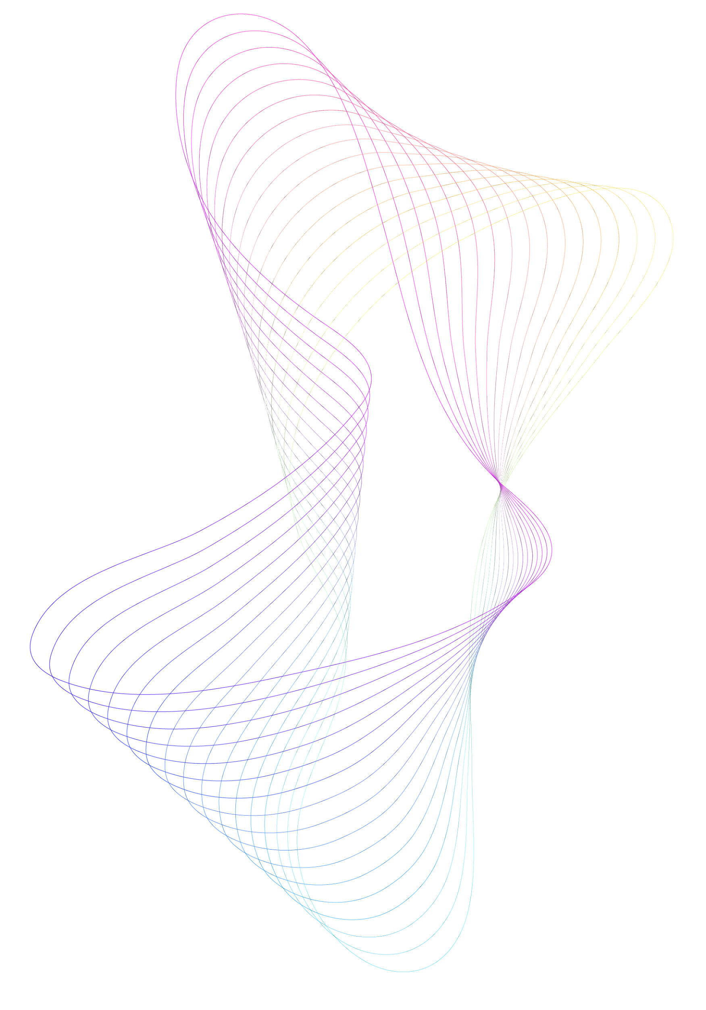
Transformer Transducer ARCHITECTURE
Audio sequence
Token sequence
The audio encoder takes as input the audio sequence and outputs an encoded representation of such signal.
The text decoder takes as input the target text sequence and returns a contextualized representation of the sequence.
The joint network combines the embeddings and applies a linear and a softmax layer.
Audio
Encoder
Text
Encoder
Joint Network
Probability distribution over the label space

Slide 5
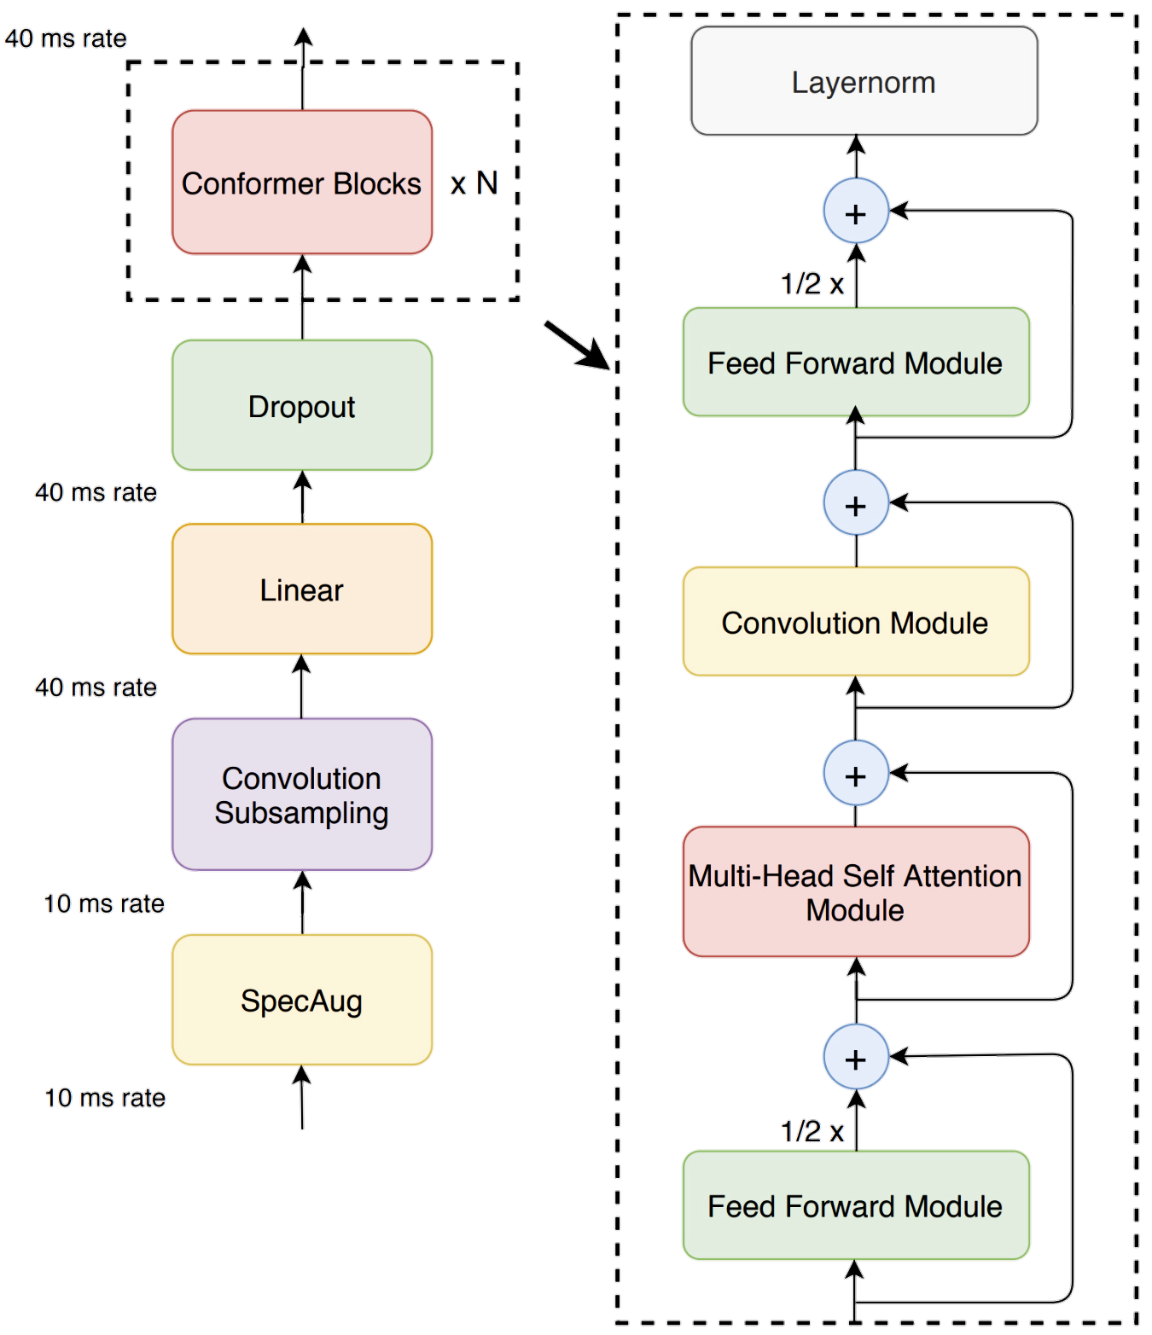
CONFORMER ENCODER
The Preprocessing consists in the creation of the Mel Spectrograms and the application of SpecAugment.
Data are subsampled with a Convolutional layer and the Conformer Blocks are applied. These blocks are composed by:
Macaron style Feed Forward Module,
Convolution Module,
Multi-Head Self Attention Module,
Normalization Layer.

Slide 6
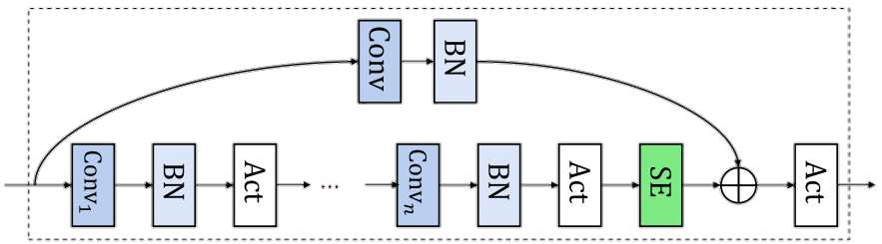
CONTEXTNET ENCODER
The Preprocessing is the same as Conformer encoder.
Then, there is a sequence of 23 Convolution Blocks which differ in some feature (e.g. num. of layers, channels, stride,...) but are all structured as follows:
Convolutional layers, with Batch Normalization and Swish Activation Function,
Squeeze-and-excitation layer,
Skip connections.

Slide 7
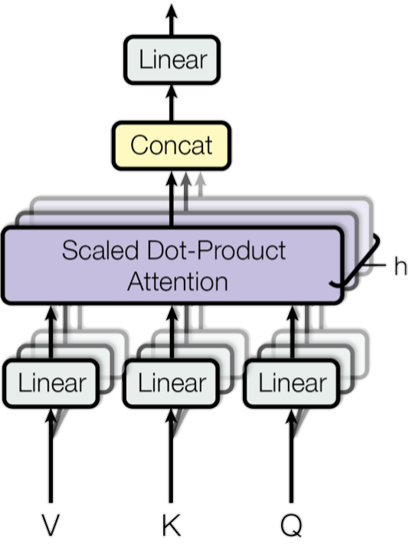
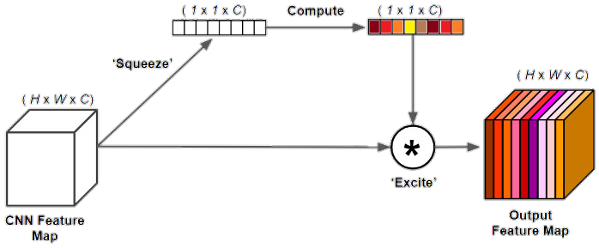
Multi-Head Self Attention (MHSA)
Squeeze-and-Excitation (SE)
SE layer is used to compress the local features in global embeddings allowing CNNs to have access to a wider context.
It’s compose by the following modules:
Squeeze module;
Excitation module;
Scale module.
MHSA is an attention mechanism in which many independent attentions are computed on an input sequence in parallel in order to capture dependencies of various extension.
Is often used in combination with the Relative Positional Encoding which are additional features about the position which helps generalization.

Slide 8
EXPERIMENTAL SETUP
We compared the smaller configurations of Conformer and ContextNet models which have around 10M parameters.
The train is done on the train-clean-100 split of Librispeech dataset, while the tests will be performed on dev-clean, test-clean and test-other (with noise).

Slide 9
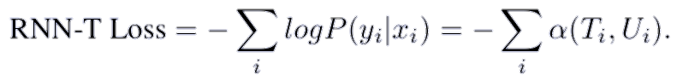
TRAINING
During the training phase, the model encodes both the audio and the target text sequence in order to compute the probabilities of all the alignments.
The RNN-T Loss is computed between the output probabilities and the target text sequence. The RNN-T Loss is the following
Where is the sum of probabilities for all paths ending at
time-frame Ti and label position Ui.
We made an Automatic Mixed Precision Training with Gradient Accumulation to deal with the memory limits and for speed up the training.

Slide 10
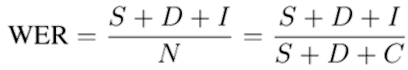
EVALUATION
For evaluating the models we use the greedy search decoding strategy in which:
With the Audio Encoders the audio sequences are encoded;
The token predicted so far along with the LSTM hidden states are encoded too using the Label Encoders.
The two representations are then processed with the Joint Network which produces the logits from which the next predicted tokens are extracted.
Once the entire sentence has been predicted, it is compared with the target one using the WER metric:
Which computes the ratio between the number of substitutions (S), deletion (D),
insertions (I) and the number of words in the target sentence.

Slide 11
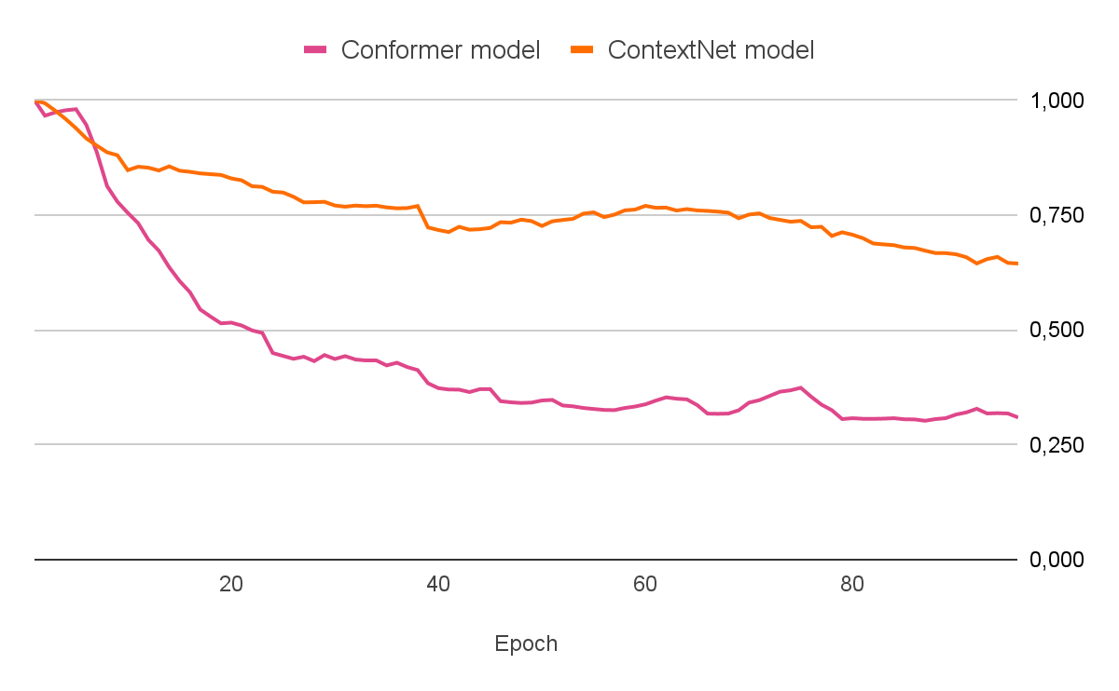
QUANTITATIVE RESULTS
 | Conformer | ContextNet
WER test-clean | 33.26 | 63.66
WER test-other | 53.04 | 78.77
WER dev-clean | 32.21 | 64.47

Slide 12
QUALITATIVE RESULTS
Prediction | he left him then for the journey to all the door and screwed him to the office | 0.333
Groundtruth | they left him then for the jailer arrived to unlock the door and escort them to the office
Prediction | david did for the lords of the prisoners but for the great explanation the greater the count | 0.591*
Groundtruth | daphne again pleaded for the liberation of the prisoners but philippus silenced her with the grave exclamation the order of the king
ContextNet
Prediction | there was a bright moonlight broke into my shadows of overhanging and ritale leaves and the modle lights and shadows glided outly across his pill features | 0.296
Groundtruth | there was a bright moonlight broken by the shadows of overhanging boughs and withered leaves and the mottled lights and shadows glided oddly across his pale features
Prediction | it wouldn’t do you in all after that story came out from me in the bless trays were he said in the case as well as all the divesing numbers of the bar to be seen there he thinks blind to the cur | 0.451*
Groundtruth | it wouldn’t do you know after that story came out for me and the vice chancellor who sat in the case as well as other judges and members of the bar to be seen there kenneth explained to the colonel
Conformer
* sentence taken from test-other Librispeech dataset, otherwise from test-clean

Slide 13
CONCLUSIONS
In this work, we compared Conformer, in which the CNNs are used to improve an attention-based architecture, and ContextNet which is an architecture based on CNNs and squeeze-and-excitation module.
Our results demonstrate that Conformer achieves better performance than ContextNet counterpart
THANKS FOR THE ATTENTION!

